Slide 1
Introduction to Phage Commander
Phage Commander is a software tool for sequencing phage genomes.
Phage Commander runs a phage’s DNA sequence through gene sequencing software tools and outputs a spreadsheet of potential genes. These tools include:
Glimmer, Genemark, Genemark HMM, Genemark S, Genemark S2, Genemark Heuristic, Prodigal, RAST, and Metagene
Phage Commander’s output can be exported as a spreadsheet.
These slides describe how to use Phage Commander
A draft paper describing Phage Commander in detail is here:
https://www.biorxiv.org/content/10.1101/2020.11.11.378802v1

Slide 2
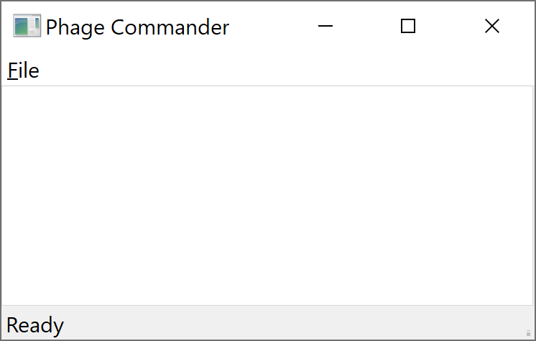
Opening Phage Commander
How to open Phage Commander:
Download Phage Commander from GitHub repository: https://github.com/sarah-harris/PhageCommander
Run Phage Commander:
Windows: Navigate to phagecommander/bin. Click on the executable: phagecom-windows.exe
Linux or Mac: Open a shell. Navigate to phagecommander. Type py phagecom.py. If you need to install any of the supporting packages, first type: ‘pip install .’ (in the PhageCommander-master directory – the directory that contains setup.py)
A small Phage Commander window will appear:

Slide 3
Using Phage Commander
How to use Phage Commander:
In the Phage Commander Window, click on the File menu, and select New.
A Select Query Tools window will open (see next slide).
If using GeneMark.hmm you will need to select your phage’s bacterial host from the drop down menu under Species
To use RAST, you will need to create a login and password at https://rast.nmpdr.org
Press Open and select your phage’s fasta file – you may use the example fasta file included in the GitHub repository: Patience.fasta
Press Query to run Phage Commander. Phage Commander will now run the sequence through the selected sequencing tools – this may take several minutes.
When Phage Commander completes, press OK

Slide 4
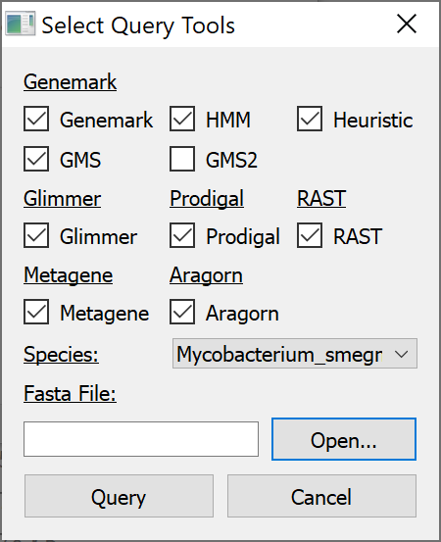
Select Query Tools Window
Leave GMS2 unchecked, all others checked
Select host from drop down menu if “HMM” box is checked (GeneMark.hmm)
Press open select phage fasta file
Press query

Slide 5
In the Event of an Error
If Phage Commander runs successfully, you will see a window saying “Done! Query Successful”
Press OK and you will see the Phage Commander output in the form of a spreadsheet (expand the window)
If phage commander encounters an error, the error message will display which program is causing the error (e.g. Glimmer, Aragorn, GMS2, etc.)
To work around this, re-run Phage Commander without including the program causing the error

Slide 6
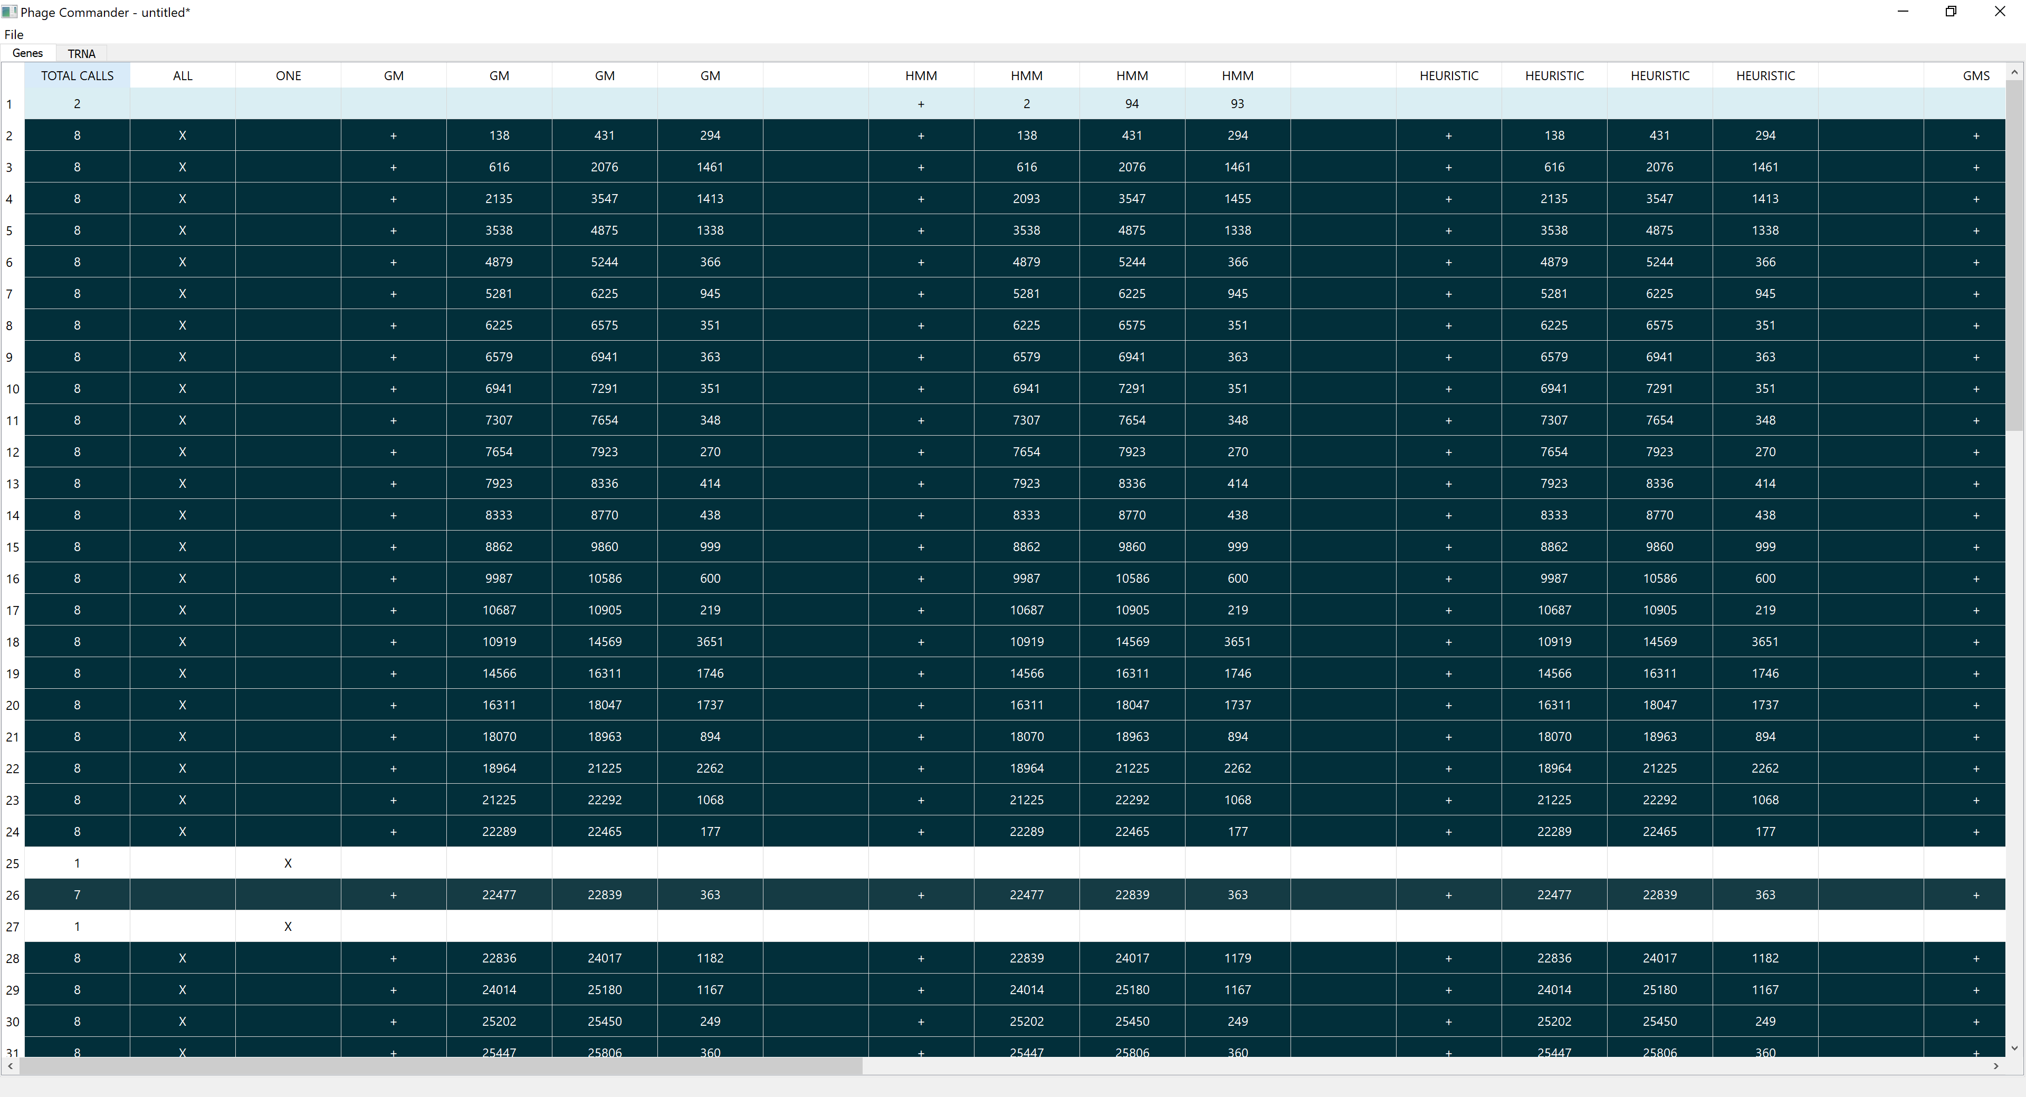
Total Calls column
Is the number of programs identifying a gene
“GM” is the genes identified by GeneMark
“HMM” is the genes identified by GeneMark.hmm
“Heuristic” is the genes identified by GeneMark Heuristic
Each row is a gene

Slide 7
Exporting Phage Commander Results
To export as excel spreadsheet, select:
File → Export → Excel
To export as GenBank (.gb) format file, select:
File → Export → GenBank
Make sure number in “Calls” box is maximum (should usually be 8)
Make sure “Less than or equal to” circle is filled
Press “Save as” and enter desired filename
Press “Export”

Slide 8
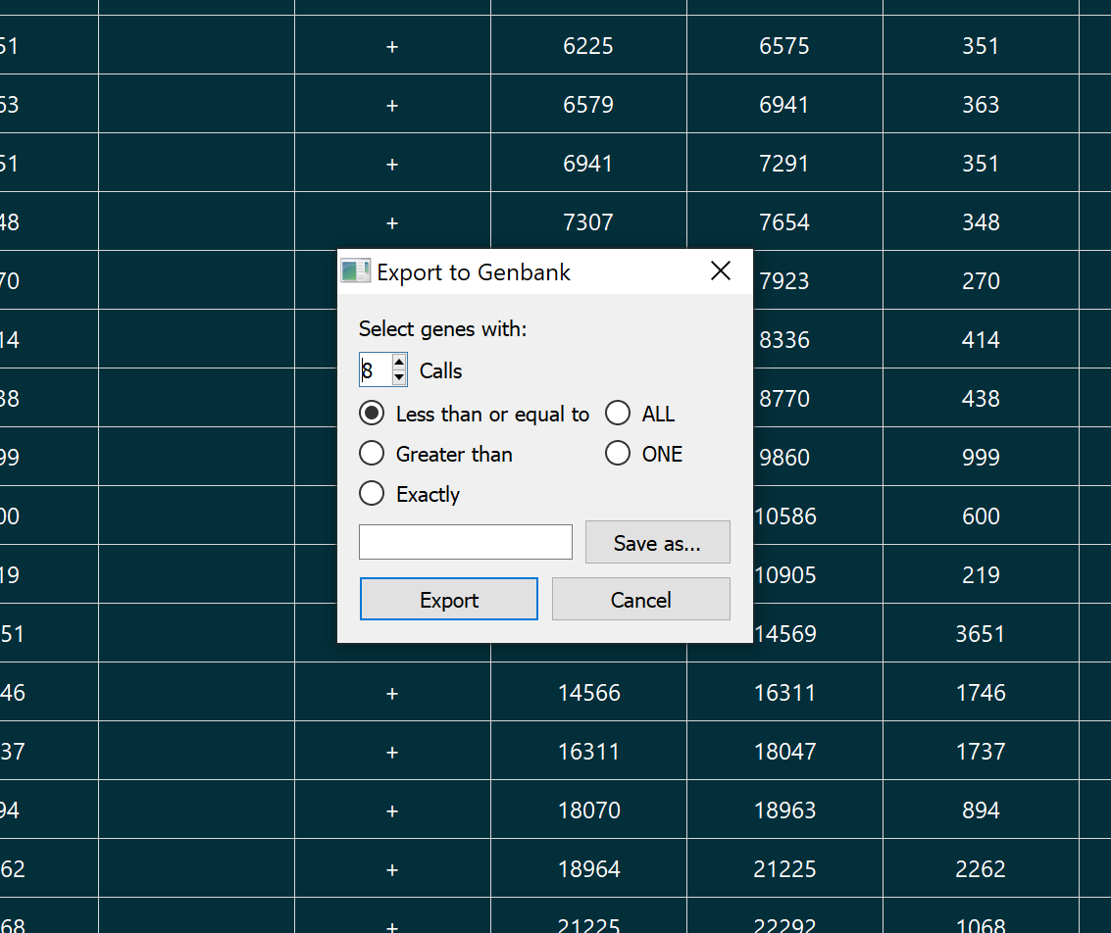
Exporting Phage Commander results in .gb format
Make sure this number is the
maximum
Press “Save as” and enter desired filename
Select “Less than or equal to”
Press “Export”

